Slide 1
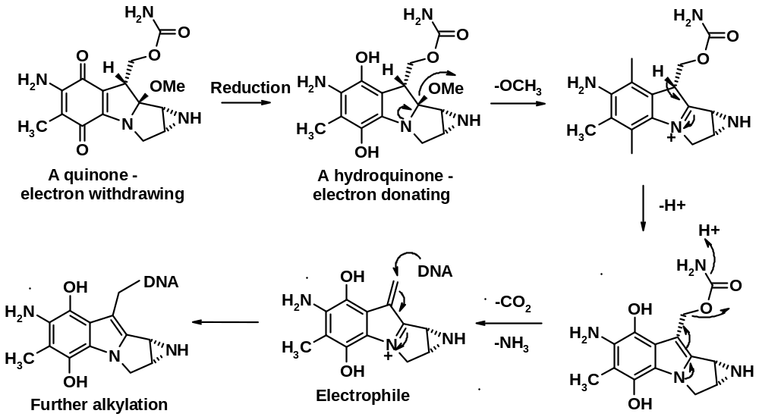
Bioprecursor Prodrugs
  Reduction example - Mitomycin C - Mutamycin® - Bristol Myers Adenocarcinoma of the stomach and pancreas

Slide 2
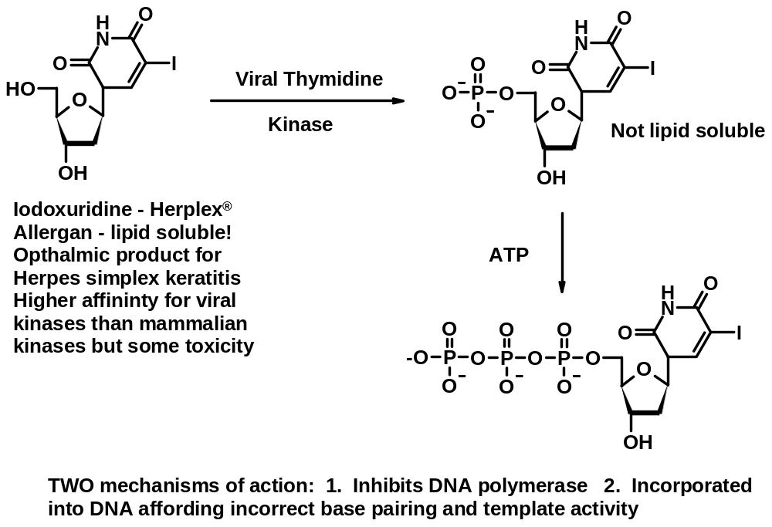
Bioprecursor Prodrugs
Phosphorylation example –

Slide 3
Chemical Delivery Systems
We have already seen 2 examples of this:
  Sulfasalazine – an azo compound
  Methenamine – An urinary antibacterial agent
Requirements
  Prodrug reach the site of action in high concentrations
  Knowledge of high metabolism at site
  Other factors
    Extent of organ or site perfusion
    Information on the rate of prodrug conversion to the active form at both target and non-target sites
    Rate of input/output of prodrug from the target site
Limit side effects and increase effectiveness

Slide 4
Chemical Delivery Systems
Types of carriers that have been used
  Proteins
  Polysaccharides
  Liposomes
  Emulsions
  Cellular carriers (erythrocytes and leukocytes)
  Magnetic control targeting
  Implanted mechanical pumps
What is the Basic Goal?
  Protect a non-specific biological environment from a drug
  Protect a drug from a non-specific biological environment
  Especially evaluated for drugs with a narrow therapeutic window especially anti-cancer agents

Slide 5
Chemical Delivery Systems
The ideal situation:
  Prodrug readily transported to the site of action
  Prodrug is rapidly absorbed at the site
  Selective and rapid conversion to the active drug
  Kidney and Liver are easy targets due to high perfusion and high metabolic rates
    Other tissue sites can be problematic for the same reasons
  Drug migrate slowly (site of action to a site of excretion)
  Ideal situation is VERY complex to achieve
Example: Methenamine
  the lower the pH, the faster the rate of formaldehyde formed
  blood pH 7.4 therefore, little formaldehyde formed

Slide 6
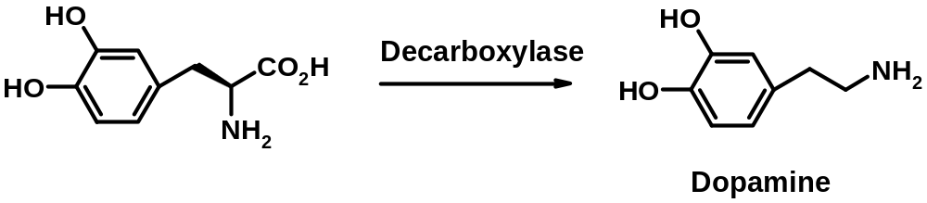
Chemical Delivery Systems
Example: Cancer Chemotherapy
  Tumor cells have a much higher growth fraction
  This translates into higher enzymatic activity that can be exploited
  Target a prodrug to these sites and exploit higher enzyme activity
Example: L-Dopa or Levodopa – Anti-Parkinsonism agent
  Larodopa® – Roche and Dopar® - Procter & Gamble
  Brain has a specific transport system for L-amino acids
  Dopamine does not cross the blood brain barrier efficiently, is rapidly metabolized by oxidative deamination, and can cause peripheral side effects

